Slide 1
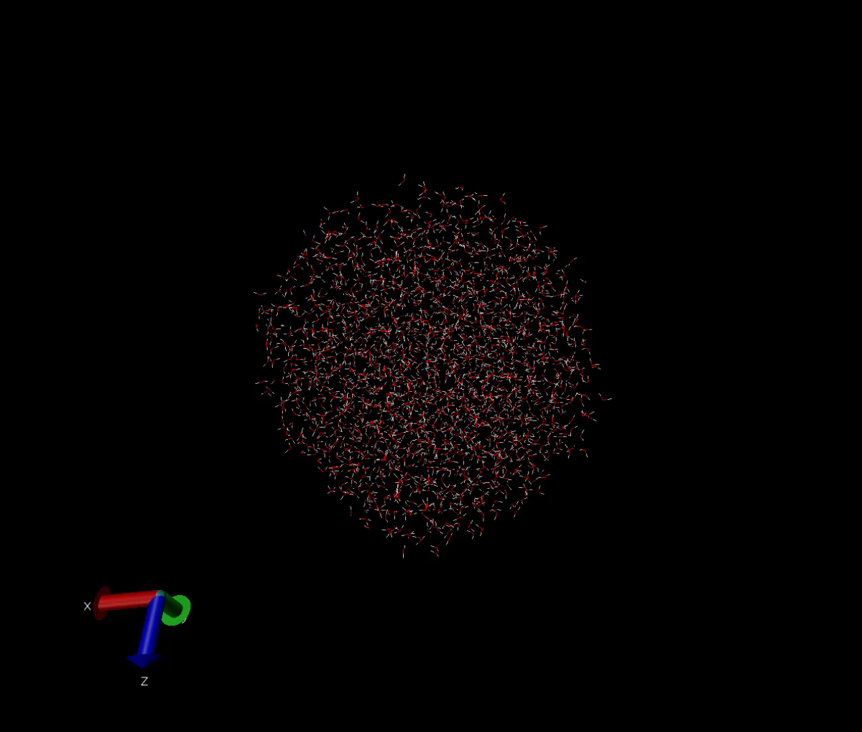
Simulating water analyzing Density
Asela Chandrasinghe
Notes:
Hi everyone my name is asela and today I will be presenting to you guys about the research I did on simulating water using molecular dynamics and analyzing density as a function of radius at various temperatures

Slide 2
Motivation
Why study Molecular Dynamics?
Why study water?
Notes:
Motivation for this study lies behind the method and the subject.
In the field of chemistry MD is a perfect method because chemistry is all about studying the behaviors of particles which in our case is molecules. This summer I’ll be doing research with johnson as well and this was a perfect opportunity for me to familiarize myself with the method I’ll be using to study proteins this summer.
And why study water? Well fist of all water is pretty freaken cool. 71% of earths surface, 60 percent of human body, there is no doubt it plays a huge role in nature it deserves all of the attention. But more practically, I could have looked at something really simple as the 2D box with particles in it, but I wanted model something with more realistitic. Water is simple enough to be able to simulate with the tools I had in johnsons lab, but with a lot of meaning because there are a lot of unique properties of water that I wanted to see if I could see them through molecular dynamics simulations.

Slide 3
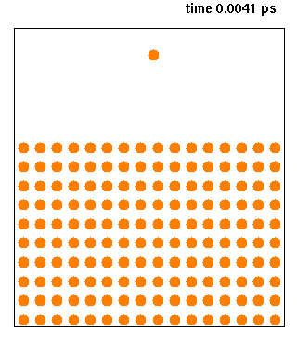
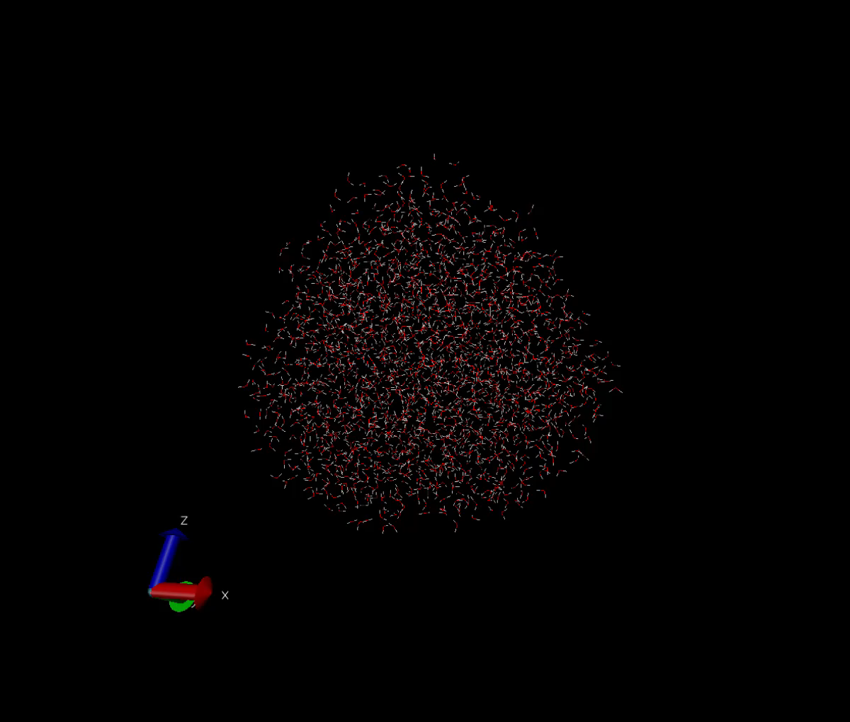
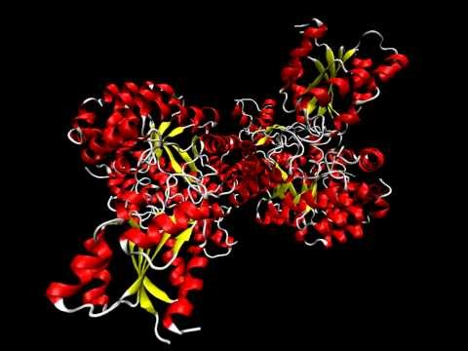
MOLECULAR DYNAMICS
https://commons.wikimedia.org/wiki/File:Cudeposition.gif
https://www.youtube.com/watch?v=ziveAfGp7lY
Notes:
Molecular dynamics (MD) simulations is a method that uses equations of motion to directly simulate the dynamics of each particle within a system. Up here we have a couple of examples of systems that MD can simulate each increasing in complexity. So as the system gets more complex, so do the equations of motion for the particles within.
It can be used to simulate something as simple as a couple of particles in a 2D box, to molecules in 3D or even protiens.
Glutamate Mutase (

Slide 4
how does MD work?
Langevin integrator
Like the Verlet method
Newtons equations of motion replaced with Langevin equations of motion
Notes:
We used a program called openMM developed by a group from standford to actually run the simulations. The specifics of how MD works is pretty complex so I’ll focus on the important factors that make these simulations possible.
Langevin integrator is simply a method that calculates the positions of the next timestep given initial positions and accelerations. SO this follows the same concepts as the euler and the rungakutta methods that we learned about in class.

Slide 5
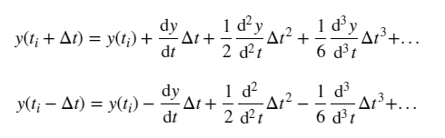
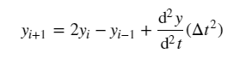
Verlet Method
Taylor expansion forward direction
Taylor expansion backward direction
Forward + backward
Notes:
The Verlet method is a numerical method that integrates the Newton’s equations of motion by taking the Taylor expansion in the forward and backward direction
Adding the two equations and simplifying gives a term to calculate the postition at the next timestep (yi+1yi+1) by using the current time step (yiyi), the previous time step (yi−1yi−1), and the accelation of the particle
Unlike the Verlet method, the Langevin integrater uses the Langevin equations of motion and these equations have the added ability to control temperature within the system and add friction to the system which is required for the aims of this project
this method allows the error term to be an order of ΔtΔt smaller than the 2nd order Runge-Kutta method and it avoids the calculation of dy/dt. Thus, this calculation provides a smaller numerical error while keeping the calculations relatively simple. However, it is important to note that the yi−1yi−1 needs to be provided by to start the algorithm. This value can be determined via another method such as Euler or Runge-Kutta

Slide 6
Forces (Ameoba)
Intermolecular
van der waal
dipole-dipole
charge- charge
quadrupole
Intramolecular
bond stretching
bond bending
Notes:
A charge to charge interactions are interaction between charged particles. Van der Waal forces are defined as momentary dipoles caused by nearby particles. Dipole-dipole interactions result in the interaction between two dipolar molecules and quadruple interactions exhibit interactions dependent on the polarizablility of the molecule.

Slide 7
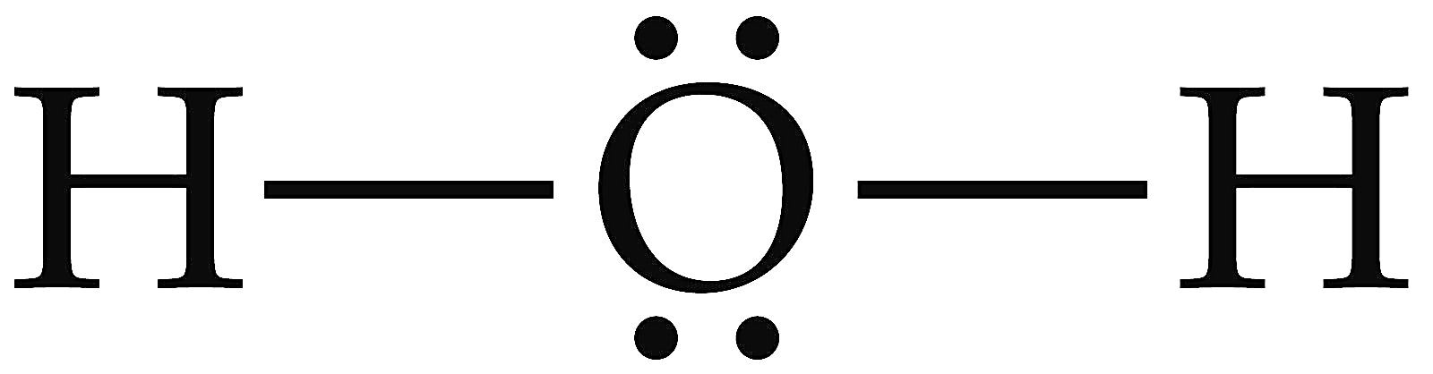
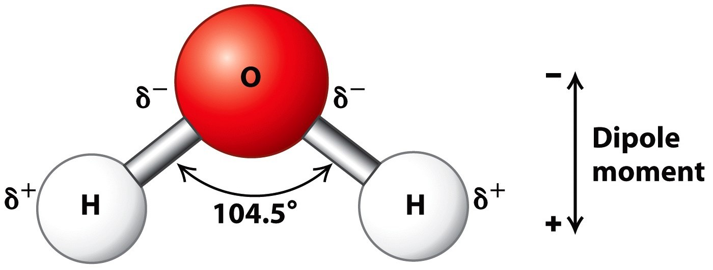
Water Structure
2 lone pairs
Bent geometry
Covalent bonds
Partial charges
Hydrogen bonding
https://alevelbiology.co.uk/notes/water-structure-properties/
http://wt.kimiq.com/lewis-dot-diagram-for-water/
Notes:
So these unqie properties of water lie behind its structure.

Slide 8
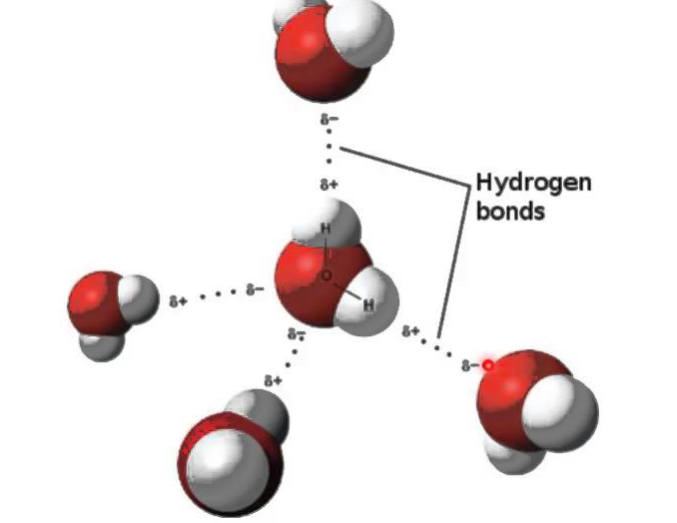
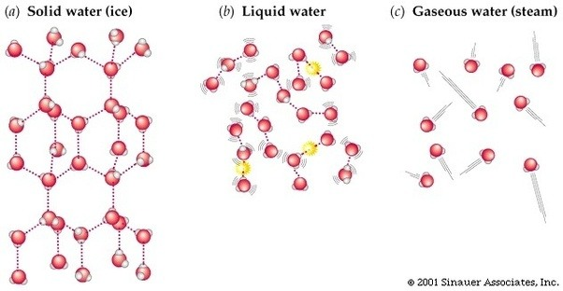
Water PRoperties
https://socratic.org/questions/how-is-hydrogen-bonding-among-water-molecules
https://chem.libretexts.org/Textbook_Maps/General_Chemistry_Textbook_Maps
Notes:
Water and density,
Hydorgen bonds are the strongest intermolecular forses. In Ice the water molecues assume a crystal structure dictated by a vast network of hydrogen bonds
SO I used MD simulations to simulate water at several different temperatures that contain each phase of water.

Slide 9
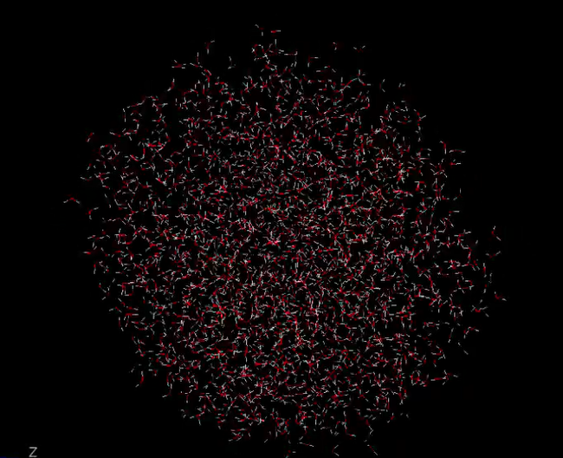
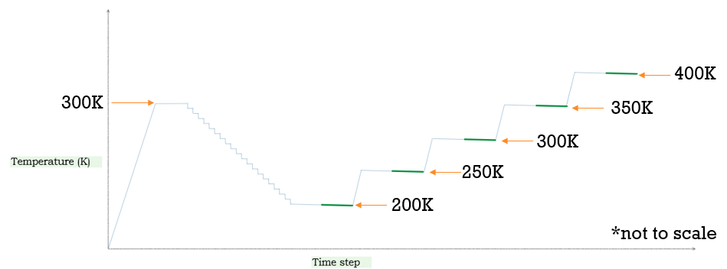
Simulation Setup
2,000 molecules
Annealing in 11,500 time steps
2,000 steps at 300K
500 steps at each temp going down
Equilibrate 1,000
Collect every 40 steps for 4,000 steps (100 samples)
Notes:
500 femtoseconds

Slide 10
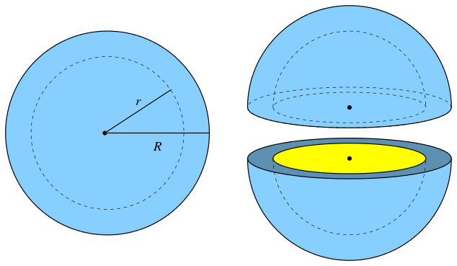
Research Aims
Density as a function of radius
Rate of change in density with respect to radius
Compare at temperatures of 200K, 250K, 300K, 350K, 400K.
By Ag2gaeh - Own work, CC BY-SA 4.0, https://commons.wikimedia.org/w/index.php?curid=49540033

Slide 11
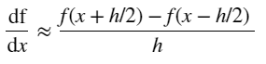
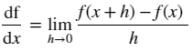
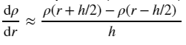
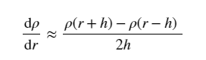
Numerical Method numerical derivative
Central Difference
Derivative Definition
Numerical Derivative Applied
= density
r = radius
h = width of spherical shell
Notes:
However, by making the size of h small, an approximation can be calculated. Accuracy can be further improved by using the central difference (see below). This alteration to the definition of the derivative still approximates the derivative using the difference between two values of f(x) at points a distance h apart. The only thing that has changed is that the two points are now placed symmetrically around point x. One point is at 0.5h above x and the other is 0.5h below x.
Since we are taking the derivative of a sampled set of data, we do not know the value of the function at x+0.5h or x-0.5h. Thus, the equation must be altered further to fit this situation. By using points in the sample that are 2h apart the central difference method can be applied. The formula for the central difference will now become:

Slide 12
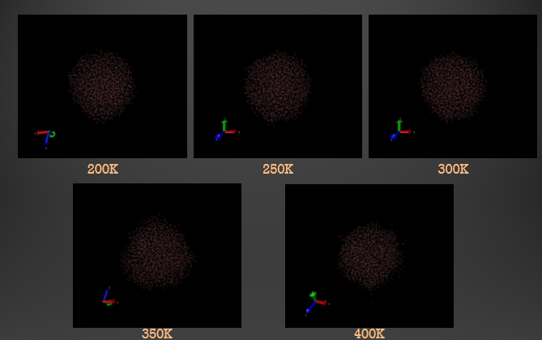

Slide 13
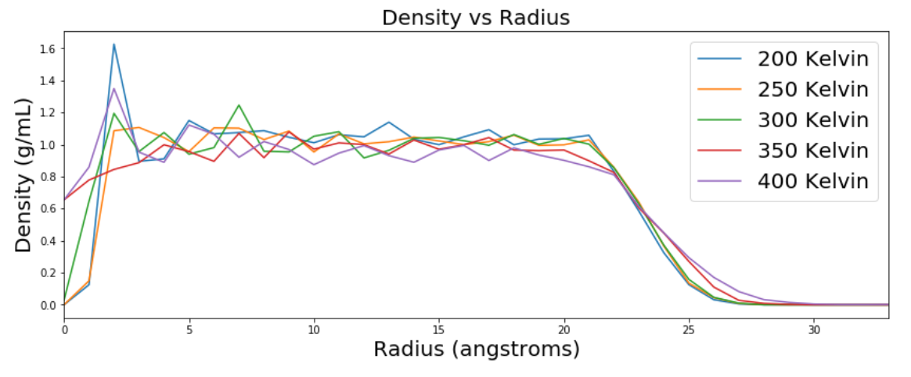
Results
Temp (K) | Density (g/mL)
243 (solid) | 0.983854
277 (liquid) | 0.9999720
373 (boiling) | 0.95835
Lide, D. R. CRC handbook of chemistry and physics. 12J204 2012.
Notes:
Figure 1 depicts the density of the water molecules vs the radius of the inner part of each spherical shell. The width of each spherical shell was set to one angstrom and each curve is representative of data collected at temperatures of 200K, 250K, 300K, 350K, and 400K. Unfortunately there is a lot of noise within the data so no significant differences be seen in regards to overall density difference between temperatures. The high levels of noise within the data can be attributed to a couple of factors.
The width of each spherical shell was set to be 1 angstrom. While it is important to decrease the size of the spherical shell as much as possible to produce a more precise numerical derivative, decreasing the size of the spherical shell increases noise within the data. Thus, setting the width of the spherical shells to 1 angstrom was too narrow.
Another factor is related to the size of the system. Only 2,000 water molecules were used in this simulation. To reduce the noise, a bigger system can be implemented. With a bigger set of molecules there can be a smoother distribution because there is a bigger sample size.
Lastly, the simulation could have been run longer to allow the water molecules to further equilibrate. This can be done in the annealing phase and in the data collection phase by allowing the simulation to equilibrate longer at each temperature before increasing or decreasing the temperature of the system.
However, despite the noise, there is still useful information that can be gathered from this data. The density of water fluctuates around 1g/ml throughout the sphere with exceptions of the center of the sphere and the outer edges of the sphere. From literature, the density of water at 243K is 0.983854 g/mL, 0.9999720 g/mL at 277K (the highest density of water), and 0.95835 g/mL at 373K (Lide, 2012). The data concentrating around 1g/mL gives good indication that the simulations is behaving as expected of water.
The deviations of the density at the center of the sphere can be explained by the fact that the volumes of the shells near the center of mass have extremely low volumes so noise is expected to increase. Similarly deviations towards the outer edges of the sphere can be due to the fact that the volume of the spherical shells are much greater. Furthermore, molecules on the outer edge of the sphere feel fewer intermolecular forces so they have more freedom to move around because they don’t have to overcome the same amount of potential energy of the intermolecular forces around them.

Slide 14
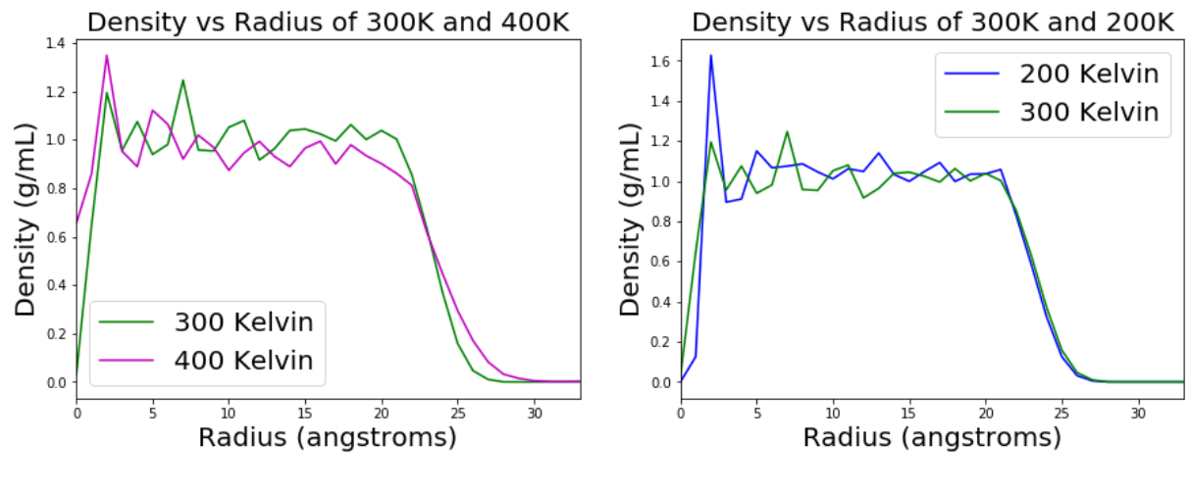

Slide 15
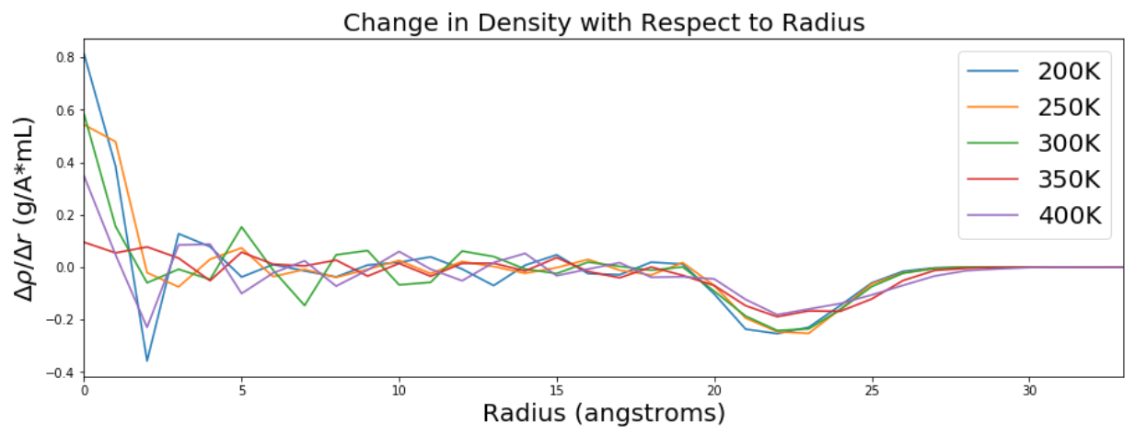
Notes:
The above figures depict the change in density with respect to radius of the 2,000 water molecules with each curve representing the system at different temperatures. As with the previous figures, there is a lot of noise within the data so also expressed in the numerical derivative. To decrease the noise, the data can either be smoothed by making the spherical shell widths larger or by increasing the sample size ( in terms of number of data points and number of water molecules).

Slide 16
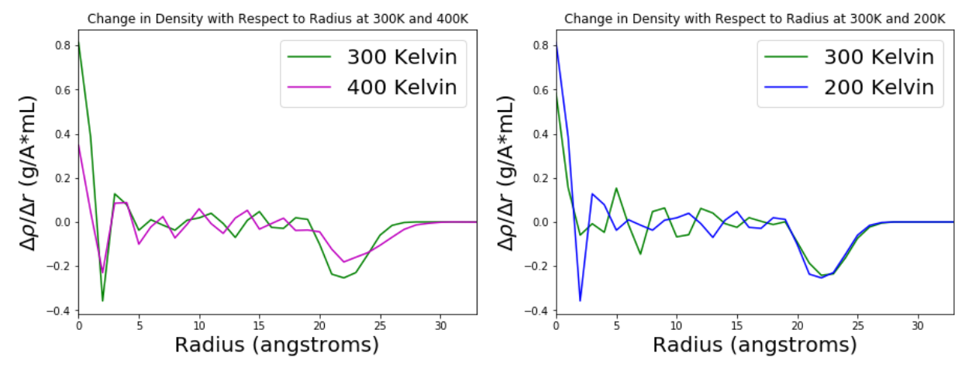
Notes:
However, looking at the figure that specifically looks at the change in density with respect to radius at 300 and 400K there is a interesting observation to note. Between 20 and 25 angstroms, the rate of change of density dips more drastically at 300K than at 400K.
At 300K the molecules have enough kinetic energy to move around but still feel the forces of the hydrogen bonds. However, at 400K the molecules should have a lot of kinetic energy. So, at the outer edges of the sphere, it is expected that the hydrogen bonds have a greater hold of the molecules at 300K compared to 400K. Thus, it is expect the density to decrease more drastically at the outer edge of the sphere at 300K.
This seems to be reflected with the more drastic dip in rate of density change. However, the noise in the data will have to be reduced to be able to more confidently make that statement.

Slide 17
Conclusions
In general water is behaving as expected
For more detailed analysis simulations need to be altered

Slide 18
Work Cited
Atkins, P. Physical Chemistry: Thermodynamics, structure, and change; Macmillan Higher Education: 2014; .
Ponder, J. W.; Wu, C.; Ren, P.; Pande, V. S.; Chodera, J. D.; Schnieders, M. J.; Haque, I.; Mobley, D. L.; Lambrecht, D. S.; DiStasio Jr, R. A. Current status of the AMOEBA polarizable force field. The journal of physical chemistry B 2010, 114, 2549-2564.
Schiller, U. D. An overview of integration schemes for molecular dynamics simulations. Lecture note 2008.
Giordano, N. J. Computational physics; Pearson Education India: 2006; .
Eastman, P.; Swails, J.; Chodera, J. D.; McGibbon, R. T.; Zhao, Y.; Beauchamp, K. A.; Wang, L.; Simmonett, A. C.; Harrigan, M. P.; Stern, C. D. OpenMM 7: rapid development of high performance algorithms for molecular dynamics. PLoS computational biology 2017, 13, e1005659.
Perlman, H.; USGS. The water in you https://water.usgs.gov/edu/propertyyou.html (accessed May 12, 2018).
Martinez, L.; Andrade, R.; Birgin, E. G.; Martinez, J. M. PACKMOL: a package for building initial configurations for molecular dynamics simulations. Journal of computational chemistry 2009, 30, 2157-2164.
Lide, D. R. CRC handbook of chemistry and physics. 12J204 2012.

Slide 19
Acknowledgements
Dr. Kevin Johnson
Dr. Danielle McDermott

